Slide 1

Artificial Intelligence in Finance at Hong Kong University of Science and Technology

Slide 2
Course Schedule
Session | Date | Topic | Application & Case Study | In-Class Activity
1 | Feb 1 | History and Overview of Artificial Intelligence | Google Experiments: Draw! | Kahoot
2 | Feb 15 | Supervised & Unsupervised Learning Classification vs. Regression | Google Experiments: Vision Sensing Case study: HireVue (Video Analytics for Recruitment) | Class survey and group formation Kahoot
3 | Feb 22 | Regression & Classification Model Assessment and Selection | Speaker: Katrina Fong Case study: WorkFusion (Robotic Process Automation) | Kahoot
4 | Mar 1 | Neural Network Basics Perceptrons | Credit analysis Case study: Clover (Temporal Unfolding) | Kahoot
5 | Mar 8 | Deep Learning Hyperparameter Optimization & Tuning | TensorFlow Neural Network Playground | Kahoot
6 | Mar 15 | Practitioners’ Perspectives Independent Consultation for Projects | Slido Q&A | Sharing from researchers and industry professionals
7 | Mar 22 | Recurrent Neural Network (RNN) | Natural language processing Case study: Deep Instinct (Cybersecurity) Speaker: Mr. Jeffrey Hui | Word2Vec Kahoot
8 | Mar 29 | Convolutional Neural Network (CNN) | Google Image Recognition Case study: SenseTime (Computer Vision) | 3D Visualization of CNN Kahoot
9 | Apr 12 | Reinforcement Learning | Case study: Osaro (Robotics), Ascent (Autonomous Driving) | Kahoot
10 | Apr 26 | Midterm Exam Independent Consultation for Projects |  | TBA
11 | May 3 | Recent Advances & Applications of AI Catalysts & Enablers of AI | Recap of concepts Case studies: Airobotics (Drones), Cornami (AI Chip) | Kahoot
12 | May 10 | Frontiers of AI Challenges in AI Commercialization | Recap of concepts Case studies: Prophesee (Computer Vision), Prowler (AGI) Speaker: Mr. Christopher Lee | Review of Neural Ordinary Differential Equations (NIPS 2018)
13 | May 17 | Synthesis & Outlook |  | Final presentations (details TBD)
Note: Details may change depending on class progress, development of relevant technologies, as well as information and feedback from students’ surveys.

Slide 3

Interact
Encourage
https://kahoot.it/
Please wait for the Game Pin
Use your full name for attendance
Reward

Slide 4
Beyond the Classroom

Slide 5
Beyond the Classroom
Session | Date | Topic
3 | Feb 22 | HireVue: Recruiting & AI
4 | Mar 1 | Industry Primer: FinTech & VC/PE
5 | Mar 8 | CV Writing & Interview Preparation
6 | Mar 15 | Company Research: Bloomberg, McKinsey Insights, Zero2IPO
7 | Mar 22 | N/A
Session | Date | Topic
8 | Mar 29 | LinkedIn & Networking
9 | Apr 12 | Industry Primer: Investment Banking
10 | Apr 26 | Certifications (CFA, CPA, GMAT…)
11 | May 3 | Industry Primer: Management Consulting
12 | May 10 | PowerPoint & Presentation Skills

Slide 6


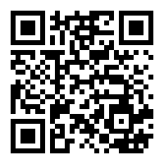
Key Responsibilities
Keen interest and experience in venture capital transactions and financial analysis
Familiar with transaction legal documents and investment structure
Understanding of the commercialization of technologies from an investor perspective
Conduct due diligence for potential investments in the AI space
Assist in the preparation of deal-related materials (e.g. data collection, industry research, comparable company and valuation analysis)
Position Requirements
Undergraduate or postgraduate students, preferably majoring in Finance, Investments, Legal Studies, and/or Business Analytics
Experience in using Bloomberg, S&P Capital IQ, Pitchbook, and Wind preferred
Exposure and understanding of the high-tech industry (especially AI/ML) a plus
Strong sense of responsibility and attention to details
Availability: Spring and Summer 2019
Number of Openings: 1-2
Renumeration: Market competitive
Office: Central • Hong Kong
Anthony Woo
CFA CAIA FRM
Associate Director
Alpha Intelligence Capital
aw@aicapital.ai

Slide 7
Final Project Options
 | Option A | Option B
Nature | Unleash your imagination | Solve a real-life problem
Organization | HKUST | HKUST & AIC
Advantage | More freedom¹ | More guidance
Requirements | N/A | Interview
Scope | No limit | Specific
Group Composition | Free for all | Managed
Deliverables | Final presentation | Monthly progress reports Monthly update meetings Final presentation
Recommendation Letter | N/A | Provided²
Full-Time Positions | Considered | Considered
Note 1: Equal amount of guidance provided for Option A but more self-initiative is called for.
Note 2: Recommendation letters provided based on satisfactory performance.

Slide 8








Robotic Process Automation
机器人与工序自动化
Full-stack AI-enabled Robotic Process Automation (RPA) solution suite for business-critical tasks spanning multiple applications and data silos
Quantum Computing
量子计算
Solution provider and platform developer for quantum and classical computing for predictive analytics, forecasting, and optimization
Computer Vision
计算机视觉
Developer of deep learning technology-based computer vision solutions aimed at a broad range of consumer and enterprise applications
Knowledge Graph
知识图表
Dynamically evolving knowledge graphs that provides inference strength across concepts, events and themes derived from a wide variety of information services
Track & Monitor
Real-Time Robotics Automation
实时机器人自动化
Deep reinforcement learning-based AI software platform that enables enhanced perception, reaction and control in real-time robotics environments
AI Chips
人工智能芯片
Deep reinforcement learning-based AI software platform that enables enhanced perception, reaction and control in real-time robotics environments
Cybersecurity
网络安全
Advanced deep learning technology-based cybersecurity products and solutions for threat detection and prevention
Music Augmentation
音乐强化
Developer of a music augmentation technology that transforms linear music to dynamically personalized music for consumers, ad-agencies, music labels, and producers
Contents are based on information from sources believed to be reliable, but accuracy and completeness cannot be guaranteed. Nothing herein should be construed as any past, current or future recommendation to buy or sell any security or an offer to sell, or a solicitation of an offer to buy any security. This material does not purport to contain all of the information that a prospective investor may wish to consider and is not to be relied upon as such or used in substitution for the exercise of independent judgment.

Slide 9
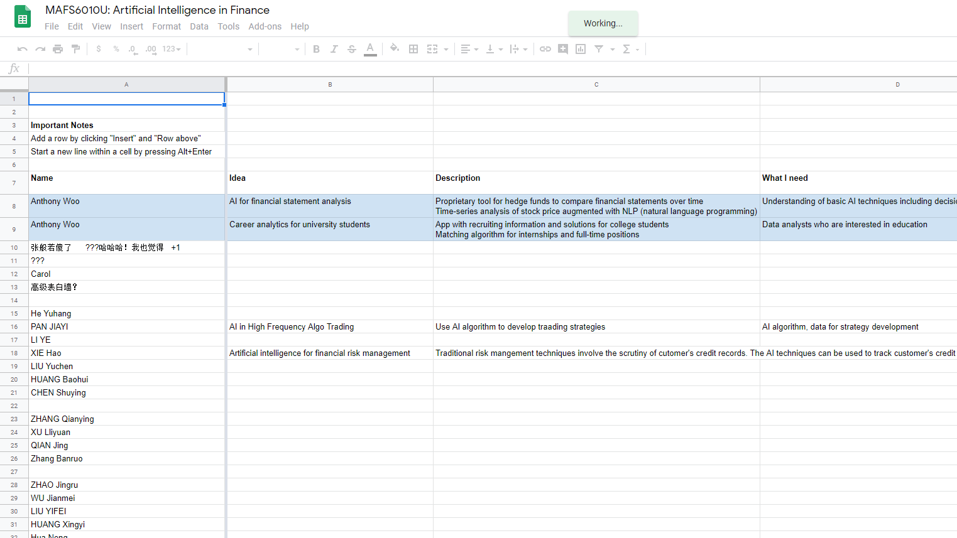
https://goo.gl/KRoiJt

Slide 10
www.slido.com
#UST

Slide 11
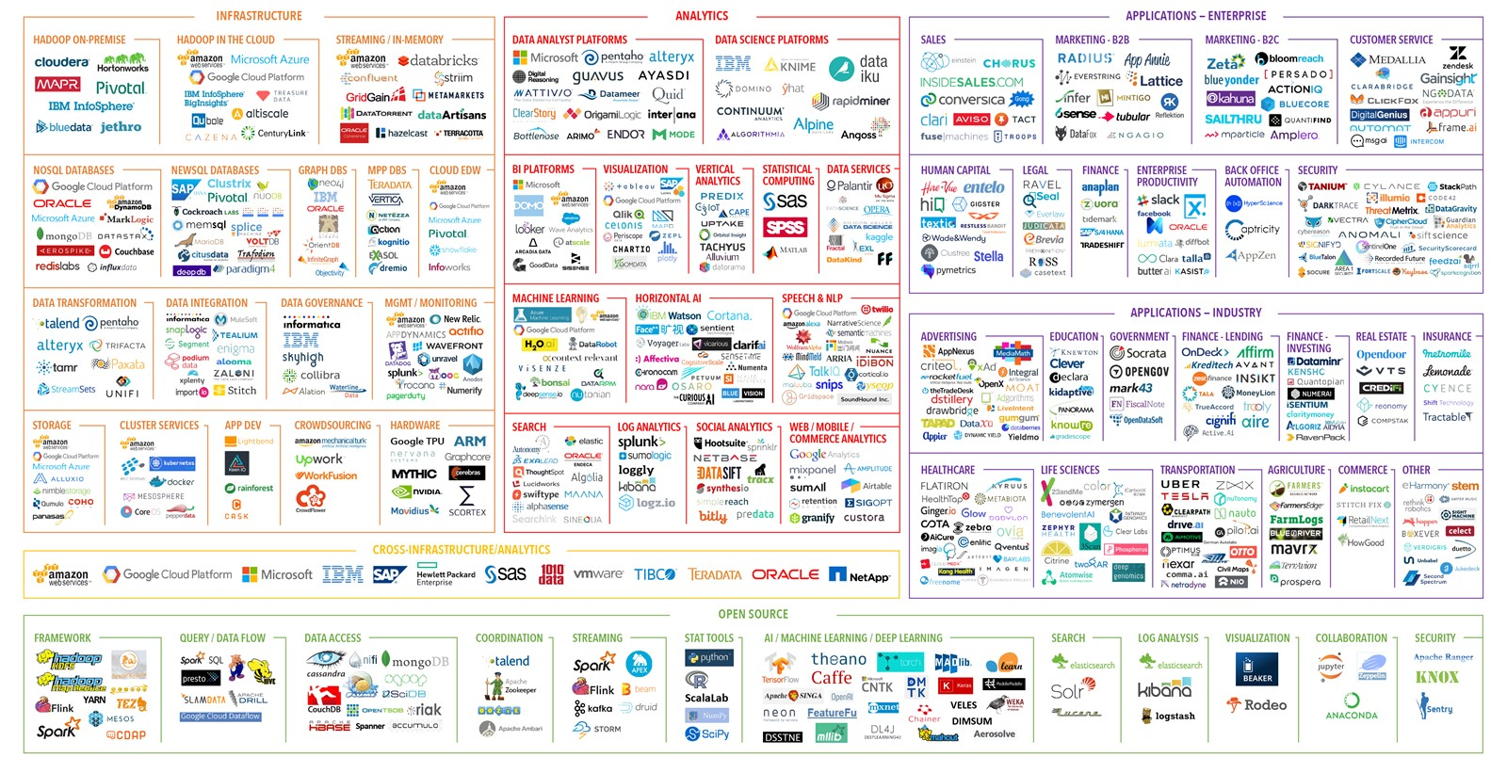

Slide 12
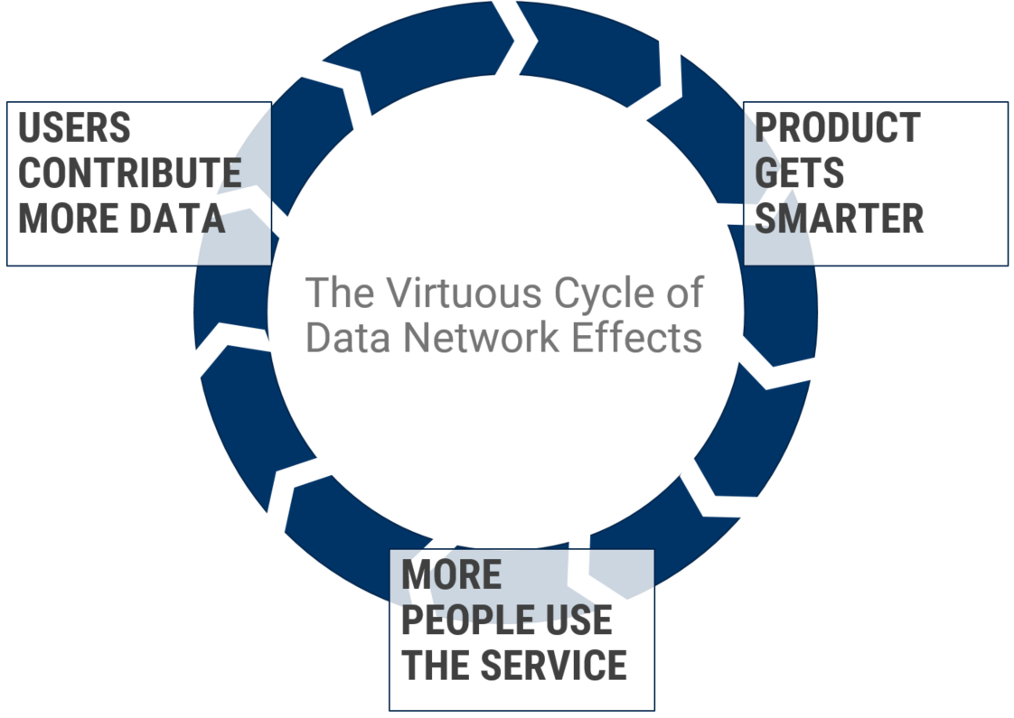

Slide 13







Katrina is a FinTech specialized recruitment consultant from Hays, and is completing Higher Education Teaching Certificate course from Harvard. She has a history of building successful working relationships with exceptional clients across the FinTech space in AI, Machine Learning, Crypto & Blockchain, Payment, Virtual Bank, Digital Transformation, Robo Advisory etc.
She has played key roles in building the technology teams for HSBC (PayMe & Jasmine FinTech), Standard Charted Bank (Virtual Banking), Hang Seng Bank (Digital Transformation via Chatbots and AI), DBS Innovation Hub, Bank of East Asia, Tencent, Alipay, Blue (first digital life insurer by Aviva and Tencent), Alipay, Accenture, KPMG, Deloitte Digital, PricewaterhouseCoopers, and leading FinTech start-ups such as WeLend, Privé Technologies, MioTech etc. Due to this wealth of knowledge, market intelligence, and extensive network, she has many repeated success in the FinTech field and retained on the region’s most high profile assignments.
Prior to recruitment, Katrina used to be a serial entrepreneur in Education Consulting as well as EF Education as Course Leader in United States & United Kingdom.
Katrina Fong
FinTech Recruiting Consultant at Hays
www.linkedin.com/in/katrinafong

Slide 14
Case Studies: HSBC & Hang Seng
HSBC’s chatbot is called Amy, while Hang Seng Bank’s are called DORI and HARO
As well as being there 24/7 to answer customer queries, the chatbots will also help to speed up services, which will save firms a great deal of money in the long run
While DORI’s role involves searching for dining discounts and making personalized recommendations to its customers through the likes of Facebook, HARO focuses on its customers’ banking needs and is available both online and through the company’s mobile app
The hardest part for most firms is not the integration of AI into their business, but finding the right people to deal with the actual maintenance once up-and-running
Source: https://algorithmxlab.com/blog/2018/01/16/hsbcs-amy-ai-chatbots-will-change-way-bank/

Slide 15
Case Studies: Clare.AI & Asiabots
Claire.AI
Chatbot start-up powered by machine learning and natural language processing, specifically in Cantonese
Claire.AI helps financial institutions provide a more personalized experience for their customers
Asiabots
Asiabots serves private clients to public clients and has developed a medical platform called Dr. Care (Clinicbot)
Dr. Care utilizes latest natural language processing technology (Chinese, Cantonese, English) and AI to assist patients from understanding their potential health problems through symptom checking to finding a suitable doctors or medical solution

Slide 16
Chatbot Job Openings
Job Openings in Hong Kong
Niche area with very limited number of vacancies, yet the demand is getting higher
Not easy to find Chatbot Developers in Hong Kong, most of the time companies would buy from Vendor/Start-up and integrate
Chatbot Product Owner, Project Manager, and Consultant are of high demand
Job Openings in Hong Kong (Cont’d)
Candidates normally only have 2-3 years of professional working experiences within the area

Slide 17
FinTech Trends in Hong Kong
Payment (PayMe, Tap & Go, Alipay, WeChat Pay)
Crypto and Blockchain
Wealth Management and Robo-Advisory
Regulatory Tech (RegTech)
Insurance Tech (InsurTech)
Corporate-Startup Collaborations

Slide 18
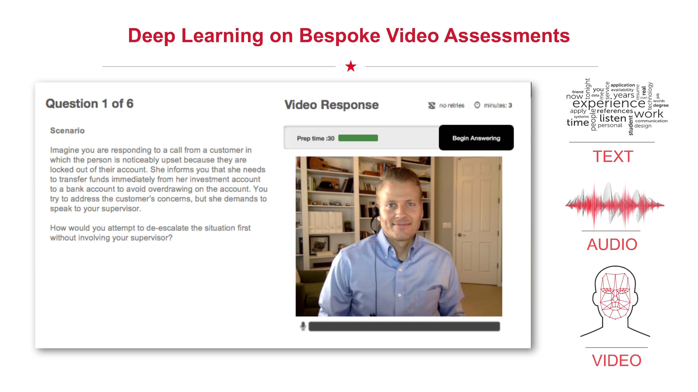

Slide 19
M
W
J
E
HU
HA
UC
MT
T
TF
CB

Slide 20
W
CDO
E
T

Slide 21
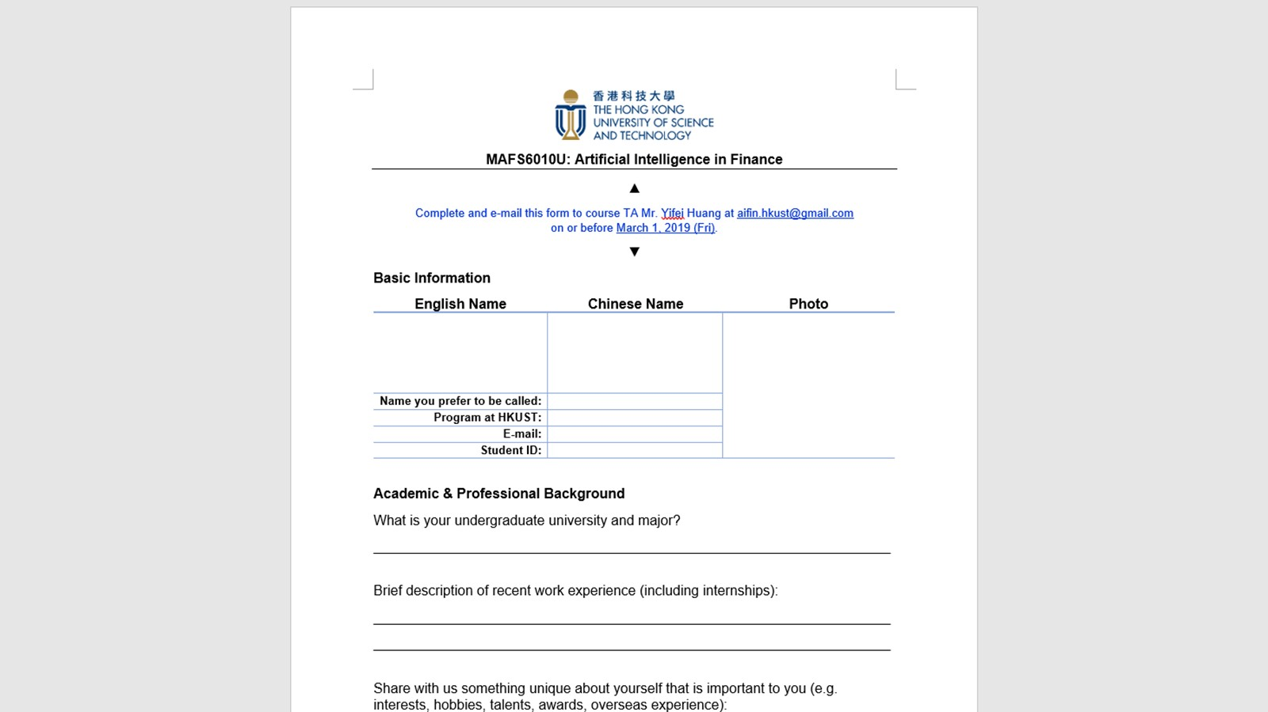
https://goo.gl/xGFxpn

Slide 22

Overview
Financing
Provider of an intelligent automation platform designed to digitize enterprise operations
Intelligent automation platform offers AI-based tools needed to automate business processes, enabling enterprises to digitize their operation, increase productivity and improve service delivery
Raised US$50 million of Series E venture funding in a deal led by Hawk Equity and Declaration Partners in May 2018 at a valuation of US$350 million
Investors include NewYork-Presbyterian Ventures, NGP Capital, Georgian Partners, Alpha Intelligence Capital, iNovia Capital, Guardian Life Insurance Company of America, and PNC Bank National Association

Slide 24
 | Case Study I | Case Study II | Case Study III
Business Problem | The bank was looking at opportunities to improve their customer experience as part of their efforts to digitize bank operations | A global performance management company that provides information about what consumers watch and buy faced challenges in product categorization and SKU management | A leading multinational software corporation was looking to transform the way they process their customer invoices
Business Outcome | The bank reduced the average time for customer onboarding from 16 days to 9 minutes | Achieved 98.5% accuracy in product categorization with up to 70% of the process automated and reduced manual effort by up to 80% | 67% reduction in the number of FTEs needed in the process and improved accuracy with 20% reduction in help desk inquiries
Source: Everest Group Report on WorkFusion (2017)

Slide 26
 | RPA | Cognitive Automation
Key Characteristics | Deterministic Rules-based automation Workflows and code are embedded manually Deployed to automate transactional and repetitive tasks of business processes Handles structured and semi-structured data | Automates knowledge-based processes Learns by itself and builds knowledge bases over time Deployed to automate conversational and complex business processes Handles all types of data including unstructured
Differentiating Technologies & Capabilities | Screen scraping Rules engine Basic analytics Library of pre-built automations Bot performance analytics | Machine learning Natural language processing Advanced analytics Data capture Workplace analytics Automated training and self-learning Library of machine learning algorithms Performance management Resource management
Source: Everest Group Report on WorkFusion (2017)

Slide 27
Bot | Key Characteristics
Agent-Assist Bot | Assist customer service agents in handling queries by automating various applications Monitor the screen of agents and guide them with the next best action
Copy-Paste Bot | Execute rules-based processes to move structured data from one application to another
Reconciliation Bot | Match transactions across disparate systems and detect errors (e.g. subjective mapping and hence such bots also require AI capabilities)
Dispatch Bot | Classify documents from multiple sources into different categories Classification often involves screening documents in multiple formats (text, images, etc.) and hence requires automation technologies such as OCR, along with RPA and AI
Data-Entry Bot | Gather relevant information from unstructured documents for relevant systems or applications Collecting and processing unstructured data with OCR and AI capabilities to read and interpret data in multiple formats
Chatbot | Directly interact with customers in natural language to solve low-complexity queries Determine customer intent and sentiments with NLP and ML and respond accordingly to customer queries or escalate to concerned departments to be handled by human agents
Source: Everest Group Report on WorkFusion (2017)

Slide 28
Type of Business Process | Sample Use Case | Smart Digital Workforce | Business Outcomes
Transactional | Validating customer information in Know-Your-Customer (KYC) process | RPA bots, humans for exceptions | Cost reduction Increased workforce productivity Increased process efficiency Regulatory compliance
Transactional | Self-service: Answering FAQs in interactive chat | Chatbots, RPA bots, and human agents for exceptions | Enhanced customer experience Increased process efficiency Improved agility
Transactional | Consumer onboarding | RPA bots with OCR for forms screening, and human agents and cognitive bots for exceptions | Cost reduction Improved quality and process efficiency Enhanced customer experience
Knowledge-Based | Customer servicing: Answering complex customer queries | Chat-assist bots and human agents | Increased workforce productivity Increased process efficiency Enhanced customer experience
Knowledge-Based | Sentiment analysis: Predicting customer emotions | Cognitive bots and human agents for actions | Increased customer satisfaction Increased workforce productivity
Knowledge-Based | Fraud detection in banking and financial services | Cognitive bots and human agents | Better management and control Increased process efficiency Regulatory compliance
Source: Everest Group Report on WorkFusion (2017)

Slide 29
Source: Everest Group Report on WorkFusion (2017)

Slide 30
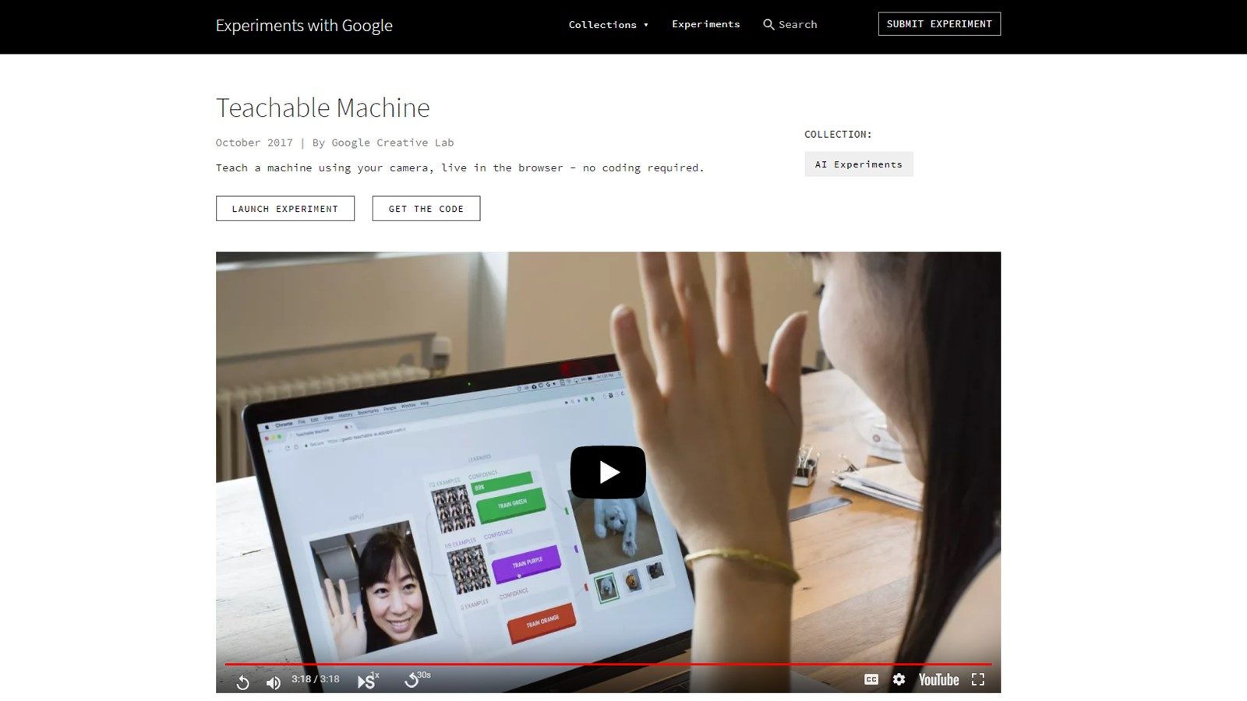

Slide 31
